Slide 1
Pls 2000 power & politics dr. shannon
Identity Politics II:
Gender & Sexual Orientation

Slide 2
Identity politics, Pt. II
I. SEX, GENDER & IDENTITY
II. FEMINISMS
III. ISSUES OF INTERSECTIONALITY
TERMS TO KNOW
Feminisms: Types and Waves #MeToo
19th Amendment Gender Binary
Heteronormativity Hostile Sexism
Obergefell v. Hodges (2015) Benevolent Sexism
DOMA DADT

Slide 3
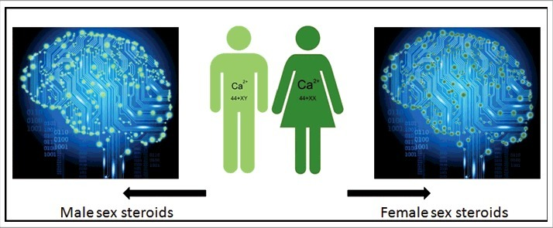
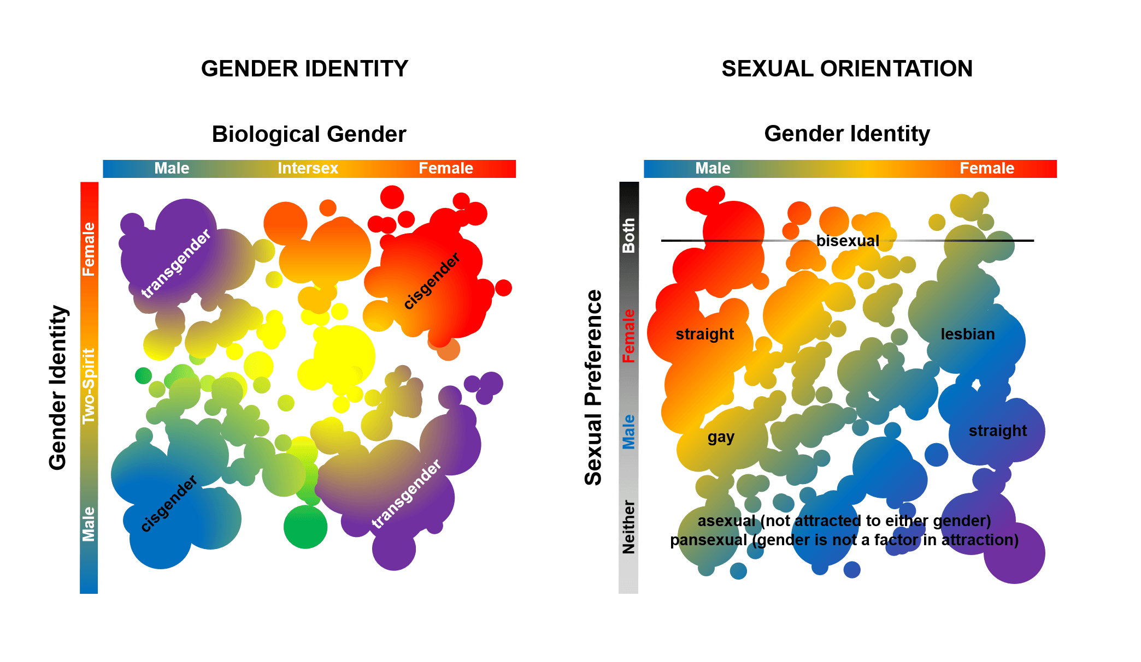
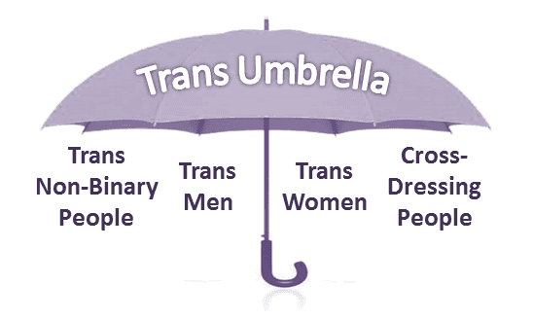
I. sex, GENDER AND IDENTITY
Biological Sex: Male, Female…
female type (two X chromosomes, ovaries, anatomical features favoring pregnancy and fetal development, breasts)
male type (one X and one Y chromosome, a penis and testicles, internal ducts for transportation of urine and sperm)
Intersex: 1+% do not conform to the two gender types that characterize the immense majority of humans
Diversity of forms of sexual development and the atypical types that occur, of chromosomal, hormonal or environmental origin
Sexual Preference: Heterosexual, Homosexual, Bisexual...
Gender Identity: Do you identify with the sex assigned at birth? Cisgender, Transgender, Gender-fluid…
https://www.ncbi.nlm.nih.gov/pmc/articles/PMC5824932/figure/f0001/
https://news.cnrs.fr/articles/how-many-sexes-are-there
https://www.ncbi.nlm.nih.gov/pmc/articles/PMC5824932/
https://en.wikipedia.org/wiki/Stereotype_threat#/media/File:Stereotype_threat_-_osborne_2007.png

Slide 4
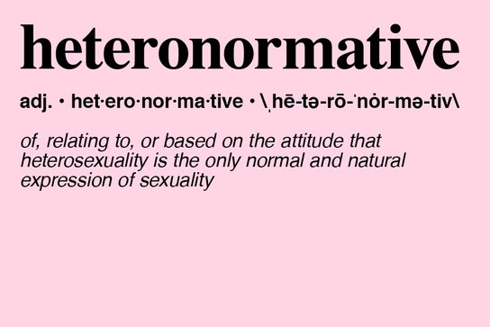
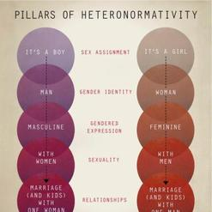
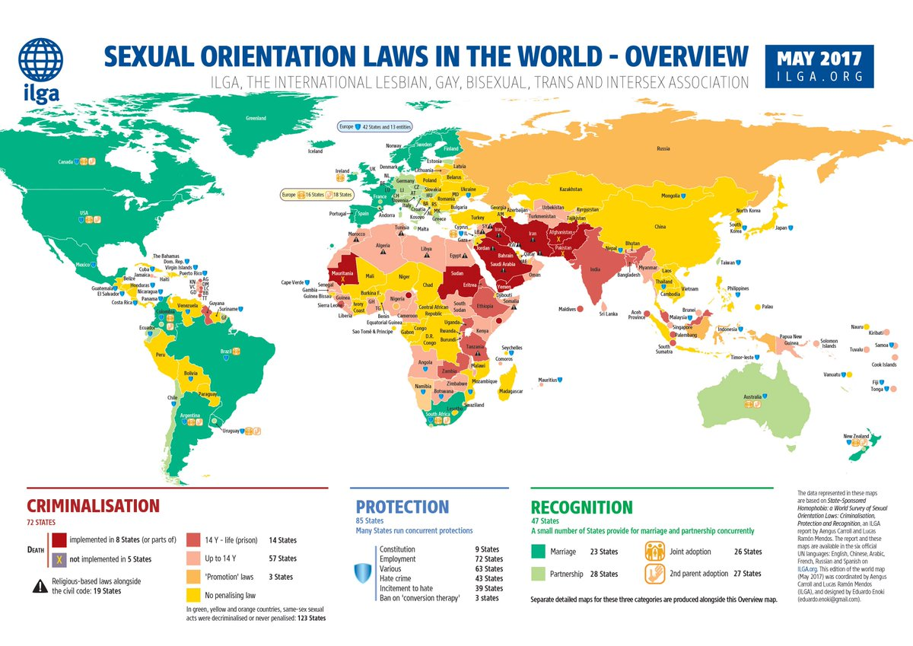
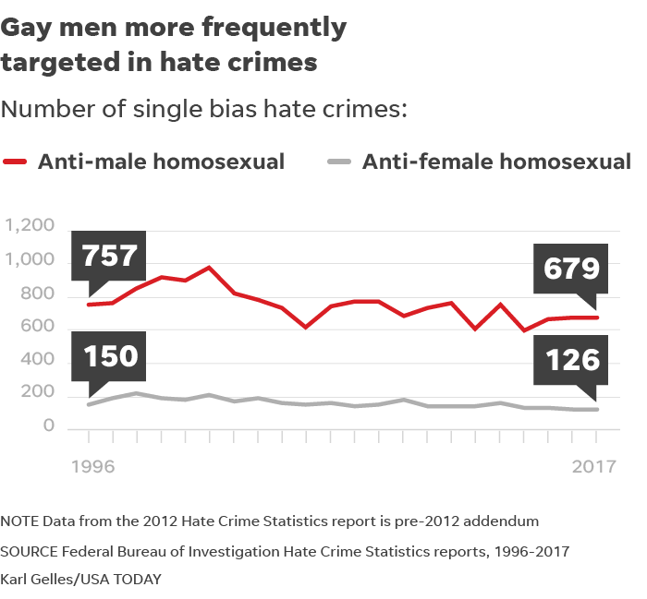
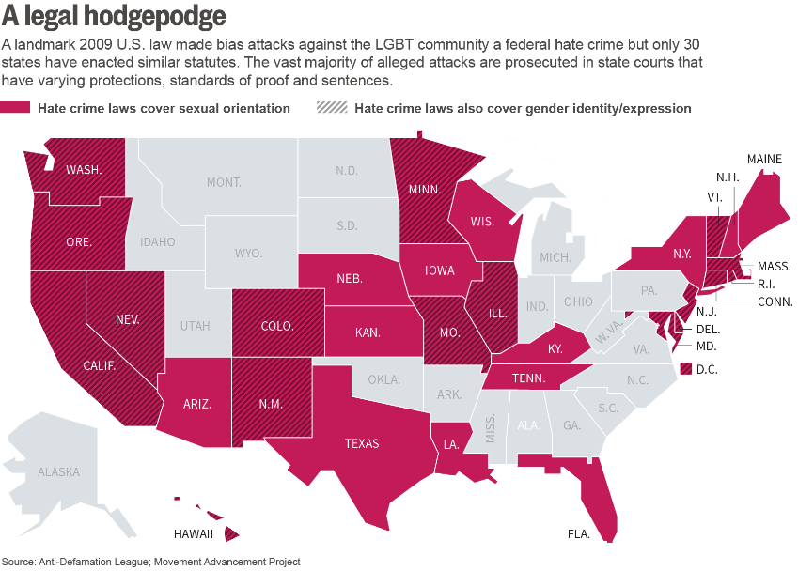
heteronormativity
Cultural naturalization and normalization of heterosexuality as normal under a gender binary (male/female) with sex-gender matched & assigned at birth
Deviations stigmatized or punished

Slide 5
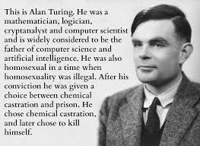
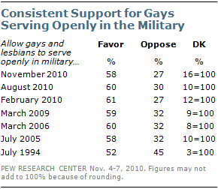
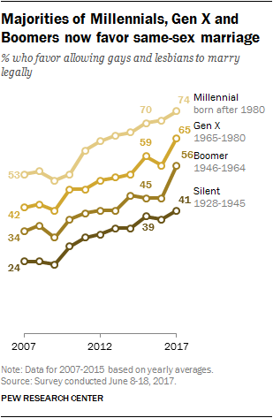
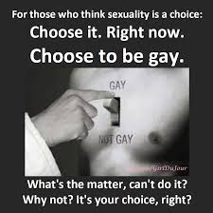

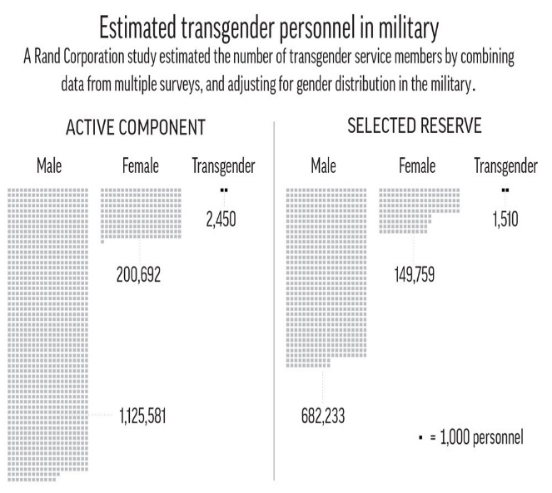
Depathologizing Homosexuality
From Sin/Crime… (Biblical times til ?)
…To Disorder (1968-)…
…To Sexual Orientation (1973- )
Right to Marry, Serve, and Work?
Don’t Ask Don’t Tell (DADT)
Repealed 2010
Trump’s Trans Ban; Biden restores
Defense of Marriage Act (DOMA): “man and a woman”
Obergefell v. Hodges (2015) legalizes same-sex marriage
https://www.psychologytoday.com/us/blog/hide-and-seek/201509/when-homosexuality-stopped-being-mental-disorder
https://www.britannica.com/topic/Defense-of-Marriage-Act
https://apnews.com/article/north-america-donald-trump-ap-top-news-coast-guard-armed-forces-997b57d4cd444bc48d67a0dbcab19373

Slide 6
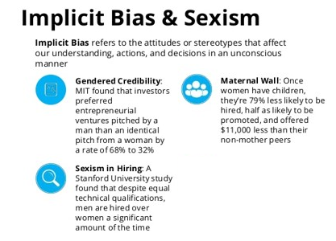
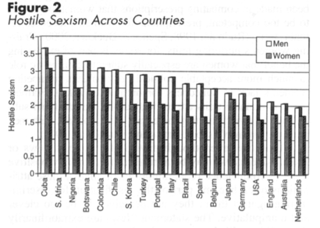
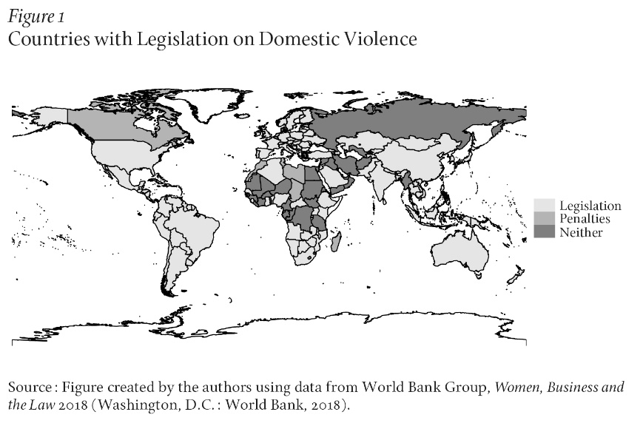
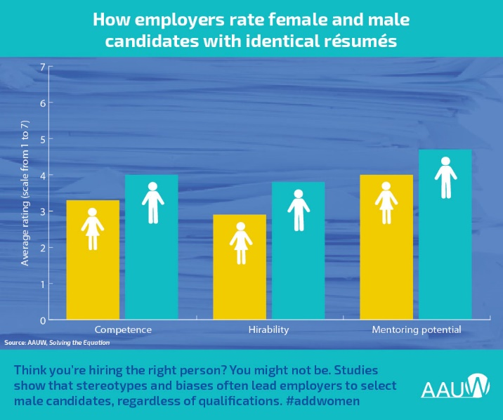
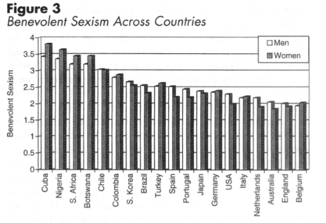
Sexism
stereotyping, prejudice and discrimination involving negative attitudes and behavior towards members of a gender
Hostile sexism: Antipathy toward women and women viewed as usurping men’s power
Benevolent sexism: Chivalrous ideology that offers protection and affection to women who embrace conventional roles
Implicit Bias Revisited

Slide 7
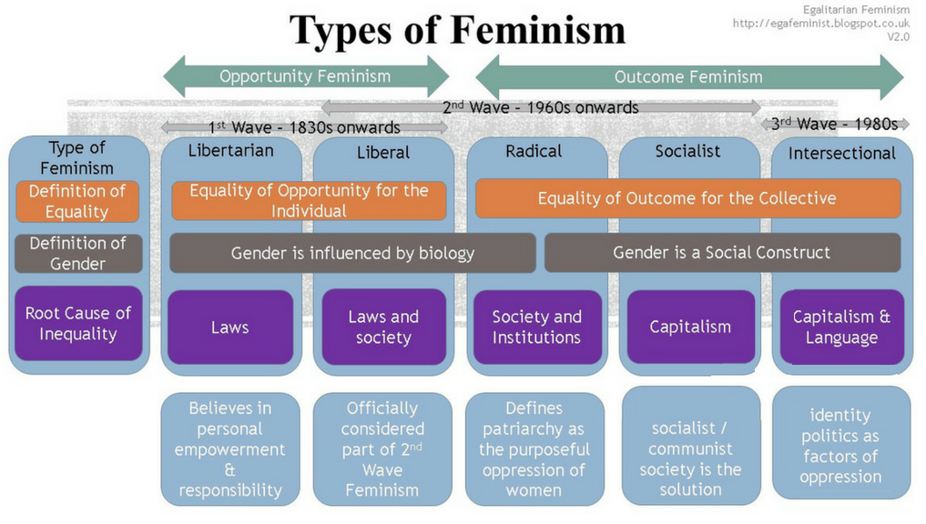
Ii. Feminisms
Explains “why disparity” – social and economic differences, with reference to discrimination against women under political and social structures of patriarchy (male created & perpetuated dominance)
Liberal Feminism: Political Rights and Economic equality of Opportunity in the public sphere
Marxist/Socialist Feminism: Economic equality of outcome to redress foregone income, pay gaps, and uncompensated domestic labor
Radical Feminism: Liberation in the Private Sphere and goals of androgynous equality, cultural femininity or even separatism
https://revisesociology.com/2017/02/03/feminist-theory-summary-sociology/
https://link.springer.com/article/10.1007/s11199-008-9424-4

Slide 8
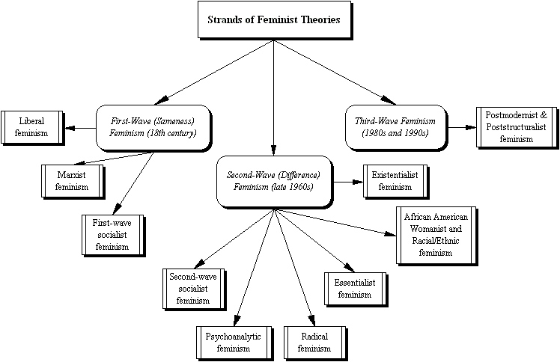
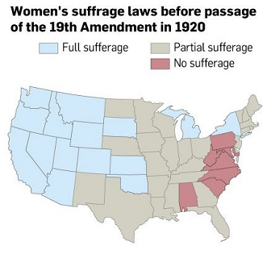
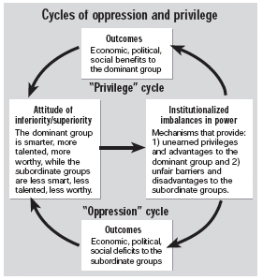
Waves of FEMINISM The waves of feminism, and why people keep fighting over them, explained - Vox
Waves: linking movements to the past as a “new chapter in a grand history of women fighting together for their rights”
1st wave (1848-1920): Suffrage First, the Rest will Follow
Seneca Falls: 200 women and 12 resolutions calling for rights
Suffrage: Lucretia Mott, Elizabeth Cady Stanton, Susan B. Anthony
19th Amendment
2nd wave (1963-1980s): The Personal is Political
Systemic sexism, role expectations & opportunity: “the world that refused to allow them to exercise their creative, intellectual faculties”
Reproductive choice (The Pill, Roe v. Wade), Educational Opportunity (Title IX)

Slide 9
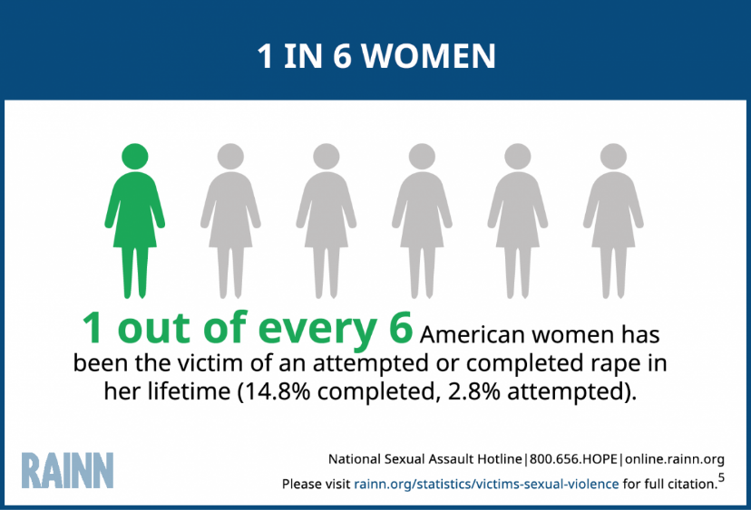
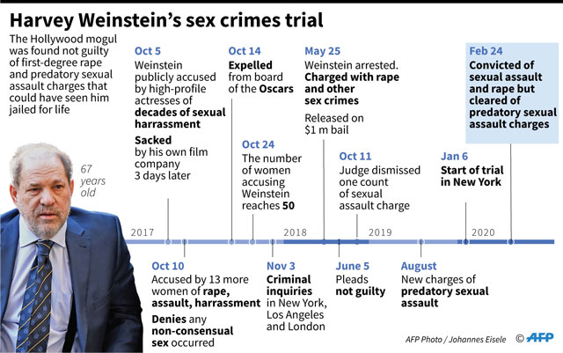
waves of feminism The waves of feminism, and why people keep fighting over them, explained - Vox
3rd wave (1991- ): Empowerment Over Infantilization
Woman or Grrrl, not Girl
Sexual Harassment
Clarence Thomas & Anita Hill
Bill Clinton & Jennifer Flowers, Paula Jones, Monica Lewinsky…
1992 Year of the Woman: 24 House Seats & 3 Senate
4th wave: Accountability Culture
#MeToo & #YesAllWomen: shared experiences of sexual harassment, assault, rape, job loss + calls for accountability
#BelieveWomen
“undeniable truth: Sexual harassment and sexual assault are endemic in society
That broad truth…tells us nothing about the merits of any individual case”
“a terrible slogan…began as an attempt to redress the poor treatment of those who come forward over abuse, but the phrase is …open to misinterpretation… False allegations, gray areas…men’s lives ruined by nebulous allegations”
Rolling Stone, Tara Reade, Christine Blasey Ford & Brett Kavanaugh
Why I’ve Never Believed in ‘Believe Women’ - The Atlantic
https://www.rainn.org/statistics/victims-sexual-violence
#YesAllWomen: Twitter Responds to Isla Vista Shooting Tragedy (nbcnews.com)

